Slide 1

Network Security
Wenjing, Qi
Shangdong Jianzhu University, Jinan, China
Site for slides: http://www.lncc.br/~borges/ist/SIN/

Slide 2
Reading List
Essential Text
· Network Security Essentials, W. Stallings, 3nd edition,
Prentice Hall, 2007.
Other Useful Texts
网络安全基础：应用与标准（第二版）张英等译
中国电力出版社
网络安全原理与应用 戚文静等
中国水利水电出版社
信息安全技术与应用实验 蔡红柳等
科学出版社

Slide 3
课程要求
双语课程，要求加强预习和复习
讲课1~13周，实验14~16周XX206
考核：平时30%+期末70%
期末闭卷，英语题干，答题中英文皆可
建议打印课件，作笔记！

Slide 4
Useful Websites
http://www.schneier.com/crypto-gram.html
Bruce Schneier’s home page. Excellent monthly e-mail newsletter analysing security issues. Very highly recommended.
http://www.securityfocus.com/
Security Focus. Detailed information on all aspects of security
http://www.sans.org/
The SANS Institute. Information on all aspects of security. Focused on training professionals
http://www.rsasecurity.com/rsalabs/
RSA Laboratories. The state of the art in cryptography
http://www.cert.org/
Computer Emergency Response Team. Up-to-date information on security incidents

Slide 5
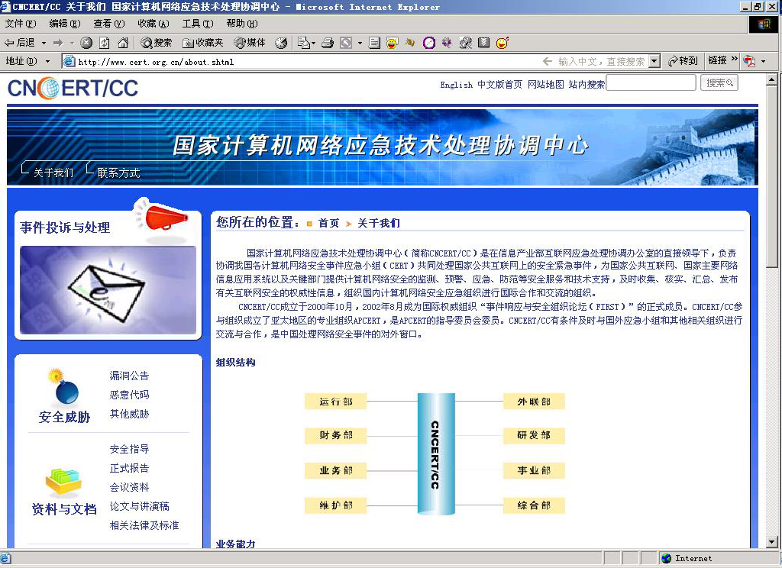

Slide 6
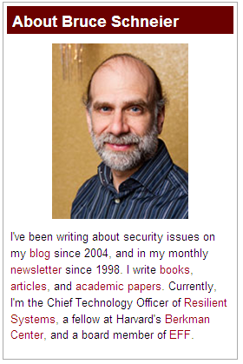
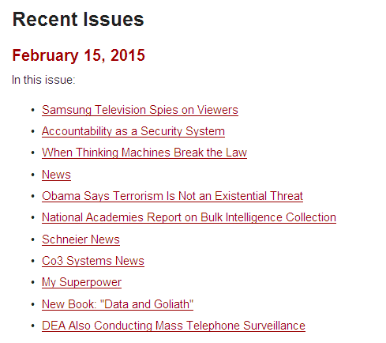

Slide 7

You reap what you sow!
Notice :listen carefully & take notes
Recommended: a printed copy of this slide, so you can take notes easily.

Slide 8

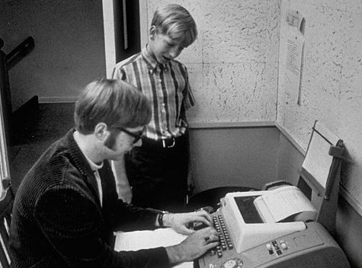

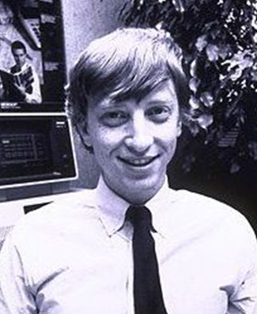

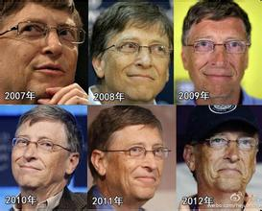
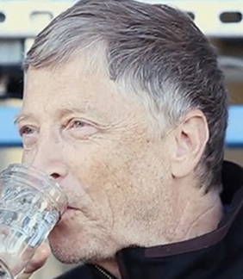
13
22
27
9
60
Time!

Slide 9
Outline
Chapter 1 Introduction
Attacks, services and mechanisms
Security attacks
Security services
Methods of Defense
A model for Internetwork Security
Internet standards and RFCs
Notes:
In this chapter, we’ll focus on the following topics:

Slide 10
1.0 Security Trends
Definition:
The term security refers to all aspects of protecting a system from all hazards.
Definition of Computer Security[1]:
”A computer is secure if you can depend on it and its software to behave as you expect.”
[1] From Practical Unix & Internet Security, Garfinkel & Spafford
Notes:
From this definition and the current conditions of computer software and networks, we can safely concluded that we are shouldering a heavy responsibilities to the security of cyberspace. In other words , it’s a tough task and never come to an end until the there we no improbity, selfishness and even mischief in the world.

Slide 11
Consequences of Breaches of security
Breaches of security can have serious legal, financial or social consequences. Some examples:
• In August 2003, an electricity blackout in the northeast of the United States and the southeast of Canada affected approximately 50 million people for several hours. It has been speculated that the Blaster worm was partially to blame [by infecting systems responsible for monitoring the electricity network and reporting faults]
• In January 2003, the Slammer worm knocked out 911 emergency telephone service in Bellevue, Washington (U.S.)
• In October 2002, a massive distributed denial-of-service attack of unknown origin briefly interrupted Web traffic on 9 of the 13 DNS "root" servers that control the Internet.

Slide 12
• In February 2000, several prominent websites were either disabled or heavily overloaded by similar attacks. These included Amazon, Yahoo!, eBay, ETrade and CNN.
• Back in September 1997, a number of crackers stopped the Coca-Cola Web site from operating. The crackers left behind a number of anti-Coca-Cola slogans.
• Earlier in that year two major credit card companies had their security compromised when an individual stole a large number of credit card numbers and subscriber information and mailed the subscribers to inform them.

Slide 13
Motivation for Network Security
• We’re all increasingly reliant on IT & networks for everyday tasks:
– E-mail used in preference to letter, fax, telephone for many routine communications.
– B2B and B2C e-commerce still growing rapidly,
despite the bursting of the Internet bubble.
– Internet as a vast repository of information of all kinds: competitors and their prices, stock markets, cheap flights,… .
– Increasing automation of supply chains of all kinds:from supermarkets to aircraft components.
– Utility companies control plant, banks move money,governments talk to citizens over networks.

Slide 14
• Increasingly inter-connected networks and the concept of identity is more and more blurred:
– If I send data over my internal network, then who else can see it or alter it? My employees? My competitors?
– Can a hacker who gets into my internal network then get access to other resources (computer accounts, stored data)? Can s/he use my network as a stepping-off point for further attacks? Am I then liable?
– A compelling Internet presence is essential for my company, but if someone can see my website, can they alter it too?
– How can I trust that this website is that of a reputable co. and not one who will steal my credit card details?
– Who has my personal information?

Slide 15
• Safeguarding the confidentiality, integrity and availability of data carried on these various networks is therefore essential.
• Authenticity and accountability are often also important: who did what and when?
• It’s not only about security of systems connected to the Internet.
– Insider threats are often more potent than threats originating on the Internet.
• It’s not only about TCP/IP networks.
– Many networks use special-purpose protocols and
architectures.
– However TCP/IP dominates in LANs and the Internet.
Notes:
Authenticity
确实性, 真实性
accountability
n.
有责任, 有义务, 可说明性

Slide 16
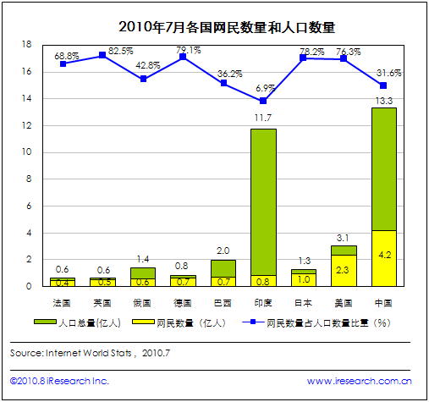
Internet 变得越来越重要

Slide 17
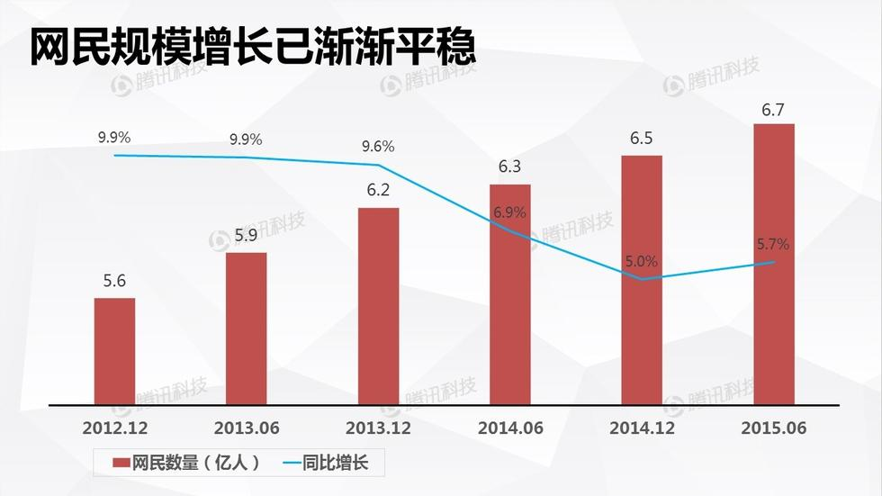

Slide 18
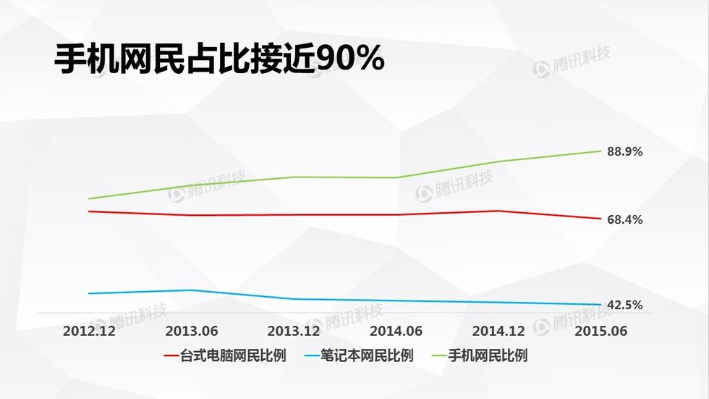

Slide 19
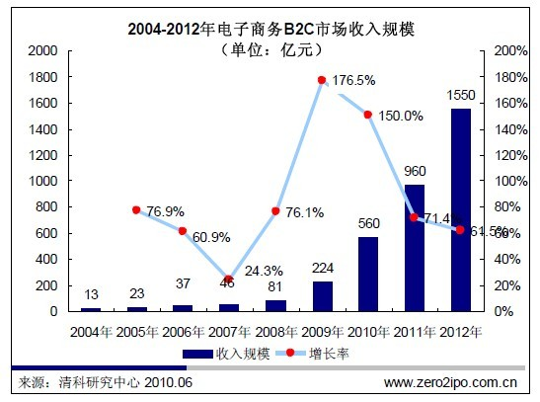

Slide 20
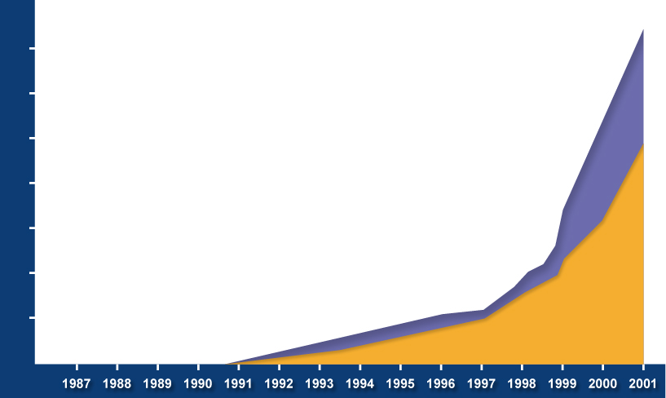

网络安全问题日益突出
混合型威胁
(Red Code, Nimda)
70,000
60,000
拒绝服务攻击
(Yahoo!, eBay)
50,000
发送大量邮件的病毒
(Love Letter/Melissa)
40,000
已知威胁的数量
30,000
网络入侵
特洛伊木马
20,000
10,000
多变形病毒
(Tequila)
病毒

Slide 21
CERT有关安全事件的统计
计算机紧急响应组织（CERT）
年份
事件报道数目
1988
6
1989
132
1990
252
1991
406
1992
773
1993
1334
1994
2340
1995
2412
1996
2573
1997
2134
1998
3734
1999
9859
2000
21756
2001
52658

Slide 22
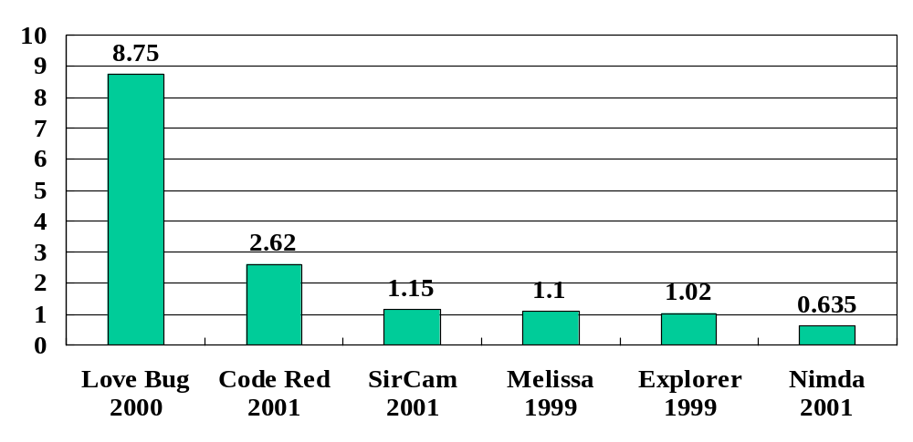
代码攻击的损失程度

Slide 23
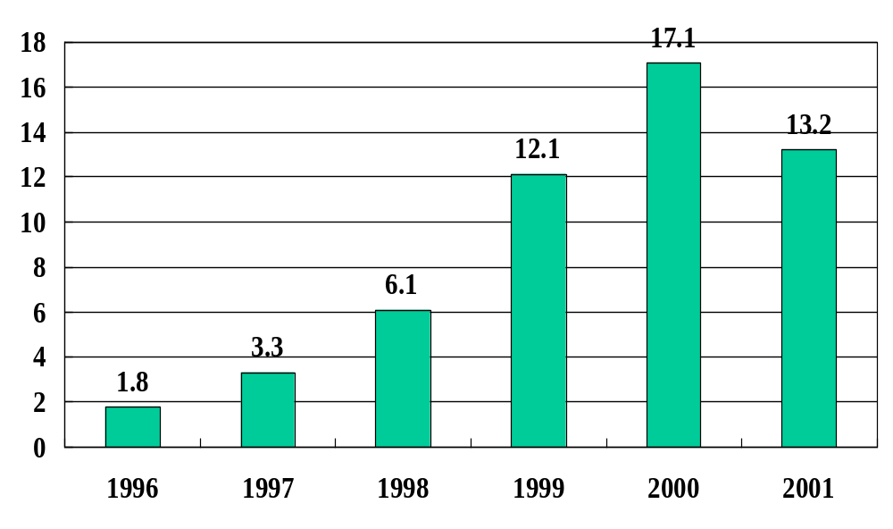
恶意代码攻击的年度损失

Slide 24
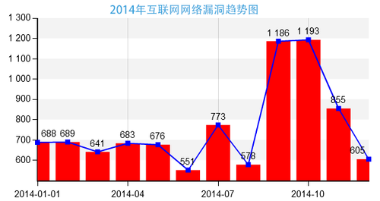

Slide 25
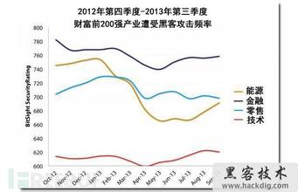
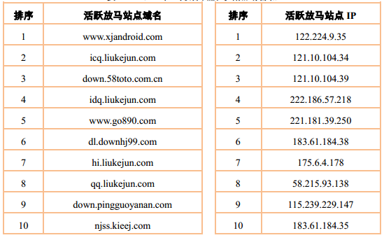

Slide 26
Reasons for insecurity (particularly of the Internet)
Poor procedural controls
• Lack of formal IT security policy in organisations. Such a policy states the rules by which people are given access to resources. Very often, security threats come from within organisations.
• Unsecured user accounts, often due to unchanged default settings on products. Some operating systems, for example, come with default guest accounts with widely known passwords.
• Allowing users to have passwords that are easy to guess
• Misconfigured equipment and services
• Servers are usually deployed using general-purpose operating systems like Windows and Unix/Linux. These OSs are complex and “holes” are frequently found. Vendors try to “patch” these holes quickly though. It is up to the system administrator to ensure these patches are deployed as soon as they become available.

Slide 27
Technology weaknesses(1)
The standards used for basic Internet protocols are public. This means that intruders know much more about how the Internet works than a closed network. However, the flip side is that the open nature of the Internet is a boon to security – most weaknesses and attacks are immediately public and patches and modifications to cover attacks are realised very quickly.
The Internet is pervasive. There is no need for complicated hardware or the burglar's tools of trade in order to carry out some intrusion: a PC and a browser will enable you to access a remote location (e.g. the home page of a bank) in a matter of seconds.
Web servers are extensible: they can be connected to all types of technologies, for example database management systems. Much of the software that carries out the interfacing to these technologies is complicated and transforms a Web server into something it was not intended to do. This makes it vulnerable to attack.

Slide 28
Technology weaknesses(2)
The speed of development of the Internet has been huge. This means that much of the software that is used was developed with its main functionality in mind, with little thought being given to the security aspects. The most secure systems are those that were designed from the start with security in mind. The Internet wasn't.
The TCP/IP protocol suite, on which the Internet is based, has some weaknesses. For example it is relatively easy to spoof (pretend to be someone else), replay a session, or to flood a router or host.
The speed of growth of the Internet has meant that technologies have had to be continually modified in order to respond to increasing demands on their functionality; often this has been achieved via insecure plug-ins that have had serious security flaws.

Slide 29
1.1 Computer Security Concepts
Computer Security : The protection afforded to an automated information system in order to attain the applicable objectives of preserving the integrity, availability and confidentiality of information system resources (includes hardware, software, firmware, information/data, and telecommunications)
[NIST 1995]
Notes:
为达到信息系统CIA目标而对信息系统提供的保护，称为计算机安全。

Slide 30

Three Key Objectives
Confidentiality
  Data confidentiality
  Privacy
Integrity
  Data integrity
  System integrity
Availability
Additional concepts
  Authenticity
  Accountability

Slide 31
Levels of Impact (pp.5)
3 levels of impact from a security breach
  Low
  Moderate
  High
Notes:
We can define three levels of impact on organizations or individuals should there be a breach of security (i.e., a loss of confidentiality, integrity, or availability). These levels are defined in FIPS PUB 199:
• Low: The loss could be expected to have a limited adverse effect（反作用） on organizational operations, organizational assets, or individuals. A limited adverse effect means that, for example, the loss of confidentiality, integrity, or availability might (i) cause a degradation in mission capability to an extent and duration that the organization is able to perform its primary functions, but the effectiveness of the functions is noticeably reduced; (ii) result in minor damage to organizational assets; (iii) result in minor financial loss; or (iv) result in minor harm to individuals.
• Moderate: The loss could be expected to have a serious adverse effect on organizational operations, organizational assets, or individuals. A serious adverse effect means that, for example, the loss might (i) cause a significant degradation in mission capability to an extent and duration that the organization is able to perform its primary functions, but the effectiveness of the functions is significantly reduced; (ii) result in significant damage to organizational assets; (iii) result in significant financial loss; or (iv) result in significant harm to individuals that does not involve loss of life or serious, life-threatening injuries.
• High: The loss could be expected to have a severe or catastrophic adverse effect on organizational operations, organizational assets, or individuals. A severe or catastrophic adverse effect means that, for example, the loss might (i) cause a severe degradation in or loss of mission capability to an extent and duration that the organization is not able to perform one or more of its primary functions; (ii) result in major damage to organizational assets; (iii) result in major financial loss; or (iv) result in severe or catastrophic harm to individuals involving loss of life or serious life threatening injuries.

Slide 32
Computer Security Challenges(pp.7)
not simple
must consider potential attacks
procedures used counter-intuitive
involve algorithms and secret info
must decide where to deploy mechanisms
battle of wits between attacker / admin
not perceived on benefit until fails
requires regular monitoring
too often an after-thought
regarded as impediment to using system
Notes:
Computer security is both fascinating and complex. Some of the reasons follow:
1. Computer security is not as simple as it might first appear to the novice. The requirements seem to be straightforward, but the mechanisms used to meet those requirements can be quite complex and subtle.
2. In developing a particular security mechanism or algorithm, one must always consider potential attacks (often unexpected) on those security features.
3. Hence procedures used to provide particular services are often counterintuitive.
4. Having designed various security mechanisms, it is necessary to decide where to use them.
5. Security mechanisms typically involve more than a particular algorithm or protocol, but also require participants to have secret information, leading to issues of creation, distribution, and protection of that secret information.
6. Computer security is essentially a battle of wits between a perpetrator who tries to find holes and the designer or administrator who tries to close them.
7. There is a natural tendency on the part of users and system managers to perceive little benefit from security investment until a security failure occurs.
8. Security requires regular monitoring, difficult in today's short-term environment.
9. Security is still too often an afterthought - incorporated after the design is complete.
10. Many users / security administrators view strong security as an impediment to efficient and user-friendly operation of an information system or use of information.

Slide 33

1.2 OSI Security Architecture
ITU-T X.800 “Security Architecture for OSI”
defines a systematic way of defining and providing security requirements
for us it provides a useful, if abstract, overview of concepts we will study
Notes:
To assess effectively the security needs of an organization and to evaluate and choose various security products and policies, the manager responsible for security needs some systematic way of defining the requirements for security and characterizing the approaches to satisfying those requirements. This is difficult enough in a centralized data processing environment; with the use of local and wide area networks the problems are compounded. ITU-T Recommendation X.800, Security Architecture for OSI, defines such a systematic approach. The OSI security architecture is useful to managers as a way of organizing the task of providing security.

Slide 34
Aspects of Security
3 aspects of information security:
  security attack
  security mechanism: detect, prevent, recover
  security service
terms
  threat – a potential for violation of security
  attack – an assault on system security, a deliberate attempt to evade security services
Notes:
The OSI security architecture focuses on security attacks, mechanisms, and services. These can be defined briefly as follows:
• Security attack: Any action that compromises the security of information owned by an organization.
• Security mechanism: A process (or a device incorporating such a process) that is designed to detect, prevent, or recover from a security attack.
• Security service: A processing or communication service that enhances the security of the data processing systems and the information transfers of an organization. The services are intended to counter security attacks, and they make use of one or more security mechanisms to provide the service.
In the literature, the terms threat and attack are commonly used to mean more or less the same thing. Table 1.1 provides definitions taken from RFC 2828, Internet Security Glossary.
Threat - A potential for violation of security, which exists when there is a circumstance, capability, action, or event that could breach security and cause harm. That is, a threat is a possible danger that might exploit a vulnerability.
Attack - An assault on system security that derives from an intelligent threat; that is, an intelligent act that is a deliberate attempt (especially in the sense of a method or technique) to evade security services and violate the security policy of a system.

Slide 35
1.3 Security Attacks
Security Attack: Any action that compromises the security of information

Slide 36
Threat
• A threat is:
– a person, thing, event or idea which poses some
danger to an asset (in terms of confidentiality,
integrity, availability or legitimate use).
– a possible means by which a security policy may be
breached.
• An attack is a realisation of a threat.
• Safeguards are measures (e.g. controls,procedures) to protect against threats.
• Vulnerabilities are weaknesses in safeguards.

Slide 37
Fundamental Threats
– Information leakage
• Disclosure to unauthorized parties
– Integrity violation
• e.g. data loss or corruption
– Denial of service
• Unavailability of system/service/network
– Illegitimate use
• Use of resource by unauthorized person or in
unauthorized way

Slide 38
Fundamental Threat Examples
• Information Leakage
– Prince Charles mobile phone calls, 1993.
• Integrity violation
– Coca-Cola website defaced with slogans, 1997
• Denial of service
– Yahoo!, 2000.
• Illegitimate use
– Vladimir Levin, $3.7M extracted from Citibank, 1995.

Slide 39
Classification of Attacks
• Passive Attacks
– Eavesdropping or monitoring to:
• Obtain message contents, or
• Monitor traffic flows
• Active Attacks
– Modification of data stream to:
• Masquerade as someone else
• Replay previous messages
• Modify messages in transit
• Denial of service

Slide 40
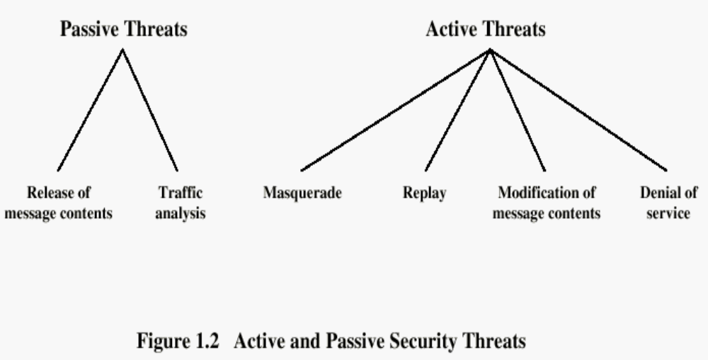
Notes:
被动：
主动：

Slide 41
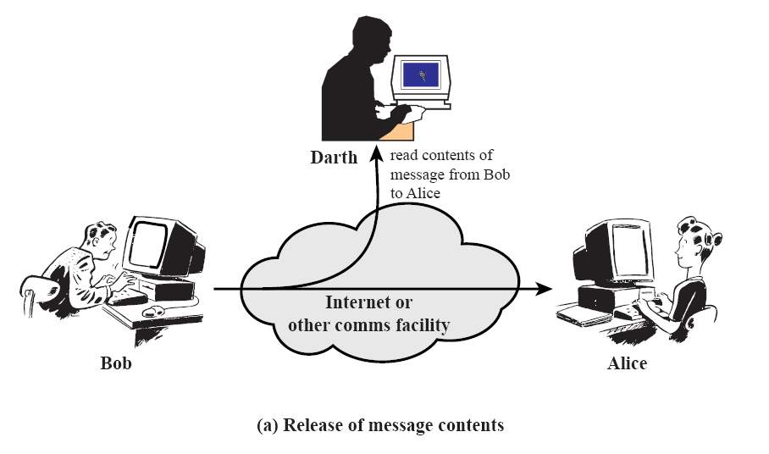
Passive Attacks

Slide 42
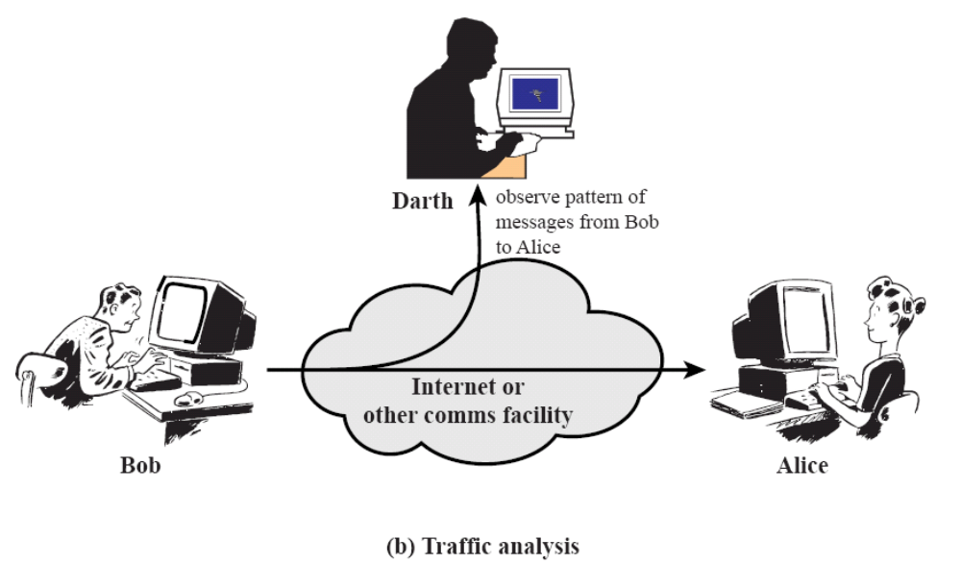
Passive Attacks

Slide 43
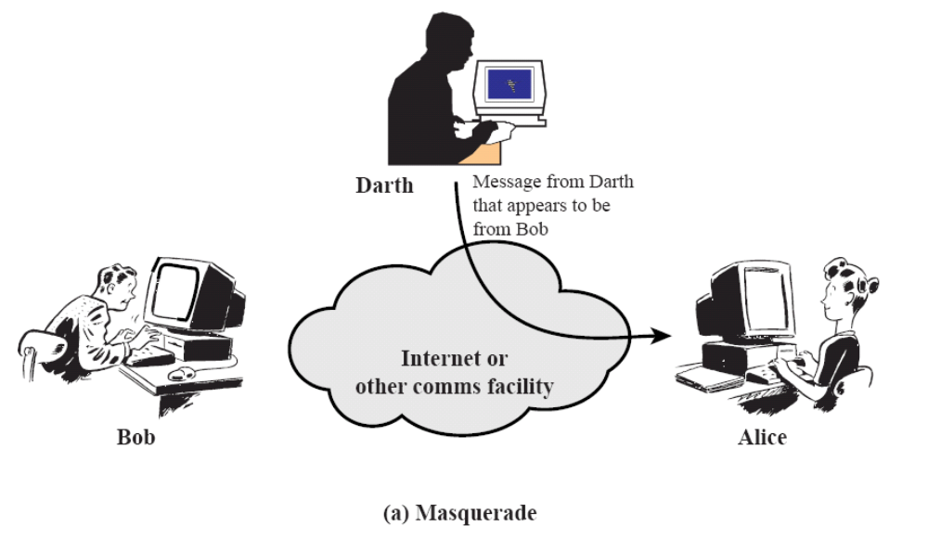
Active Attacks

Slide 44
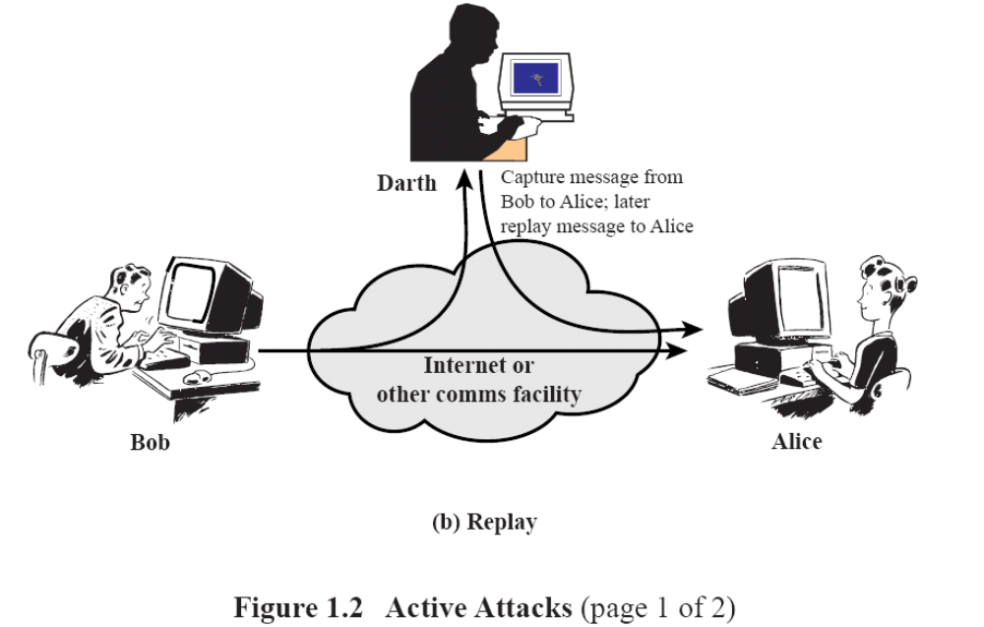
Active Attacks

Slide 45
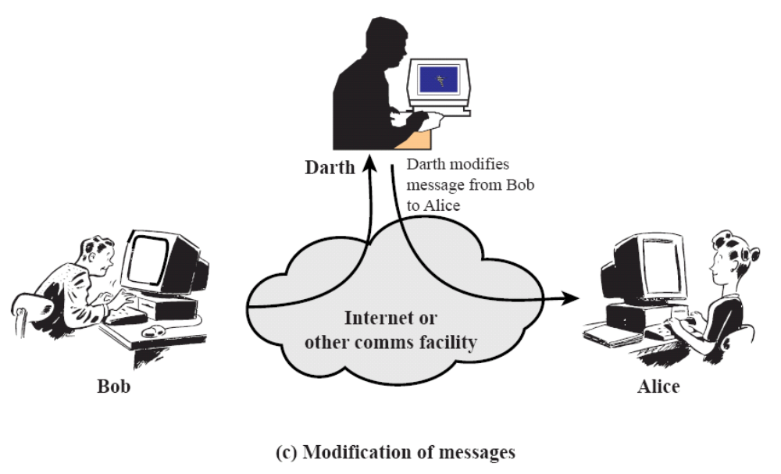
Active Attacks

Slide 46
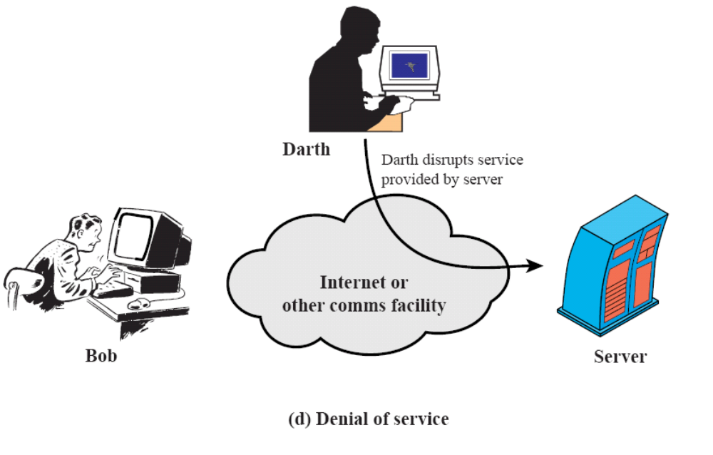
Active Attacks

Slide 47
Typical attacks(1)
Denial of Service attacks (DoS)
A denial of service attack is one in which an intruder carries out some action which either prevents access to a service or degrades the quality of the service.
Examples of denial of service attacks include:
• Running a program on a computer that will spawn other programs that, in turn, spawn further programs, thereby clogging up the system’s resources. This type of program is known as a “worm”
• Email worms – these are emails containing attachments that, when executed, cause a number of new emails (e.g. 50) to be generated, each of which contains the attachment. Each of these 50 may then generate a further 50 emails, and thus mail servers are suddenly forced to handle a very large volume of email.
• Distributed Denial of Service (DDoS) – a hacker, having taken control of a large number of Internet hosts, simultaneously launches a large number of requests to a web server, causing it to become overloaded and possibly crash.

Slide 48
Typical attacks(2)
Viruses
Viruses are a form of malignant code that subverts functionality. A virus is a program that attaches itself to files that are resident on a computer - a process known as infection. Once a virus is established on a computer it can replicate itself, both inside the computer and on computers that are connected to it.

Slide 49
Typical attacks(3)
Trojan Horses
A Trojan horse is malicious code that looks legitimate but attempts to do something that the user does not expect it to do. destroys many of these files.
Trojan horses can be used for financially criminal purposes such as discovering passwords and secure network information or they can be used to destroy resources or carry out a denial of service attack.
The major problem with Trojan horses is that they are very difficult to detect. They often masquerade as utilities that would normally be found stored on a computer or would require installing on a computer.
A web-based example of a Trojan Horse is a piece of JavaScript in a web page that pops up a window which, when a user browses a particular page, will prompt the user for some important information such as a credit card number or a password.

Slide 50
Typical attacks(4)
Scanners
A scanner is a program that detects security weaknesses, and help system administrators pinpoint security weaknesses in a system. However, some of the scanners that have been developed can be used outside a network in order to probe it for potential ways of intruding or crashing the computers on the network.

Slide 51
Typical attacks(5)
Password crackers
A password cracker is a program that attempts to find out a user's password or the identity of a number of passwords stored in the password file of a computer.
Most password crackers either attempt to discover a password by consulting a dictionary of words that users habitually employ for passwords and check on characteristics of passwords which make them easy to detect such as a short password of a few alphabetic letters which could be detected by a brute force attack.
It is important that passwords are not easy to guess.

Slide 52
Typical attacks(6)
Sniffers
These are devices that read the packets of data that travel around a network, and can be illegally used for siphoning off sensitive data (e.g. passwords as users enter them). An intruder might install a sniffer at a strategic point in a network such as a gateway and read the traffic that is passing through the gateway.

Slide 53
Typical attacks(7)
Buffer Overflows
Many programs that respond to external requests are vulnerable to malformed input. If the input is larger than the data structure available to accept it, it may be possible to insert machine code that can subvert the intended purpose of the program and call an unintended external program (e.g. a command prompt). If successful, the attacker gains whatever privileges the running application has.
This problem is extremely common (and has been around for 40 years!). Programs written in C/C++ are especially vulnerable.

Slide 54
Typical attacks(8)
Attacks on specific technologies and applications
Certain technologies, particularly new ones, are prone to attack. Java applets and Active X components are particularly dangerous as the web browser executes them automatically when a user browses to a web site containing the applet or component. Applets have been created that read and write system files.
Likewise, certain applications are very prone to attack. This is usually due to their ubiquity or the fact that they are very complex and poorly-tested. For example, many security experts recommend against using Microsoft Internet Explorer due to the frequency of vulnerabilities.

Slide 55
1.4 Security Services
Security Service: A service that enhances the security of data processing systems and information transfers. A security service makes use of one or more security mechanisms.
Notes:
Confidentiality is the protection of transmitted data from passive attacks(protect content of traffic ,and protect traffic flow from analyzing,such as source,destination,frequency,length or other traffic features )
Authentication

Slide 56
Confidentiality (privacy)
Authentication (who created or sent the data)
Integrity (has not been altered)
Non-repudiation (the order is final)
Access control (prevent misuse of resources)
Availability (permanence, non-erasure)
  Denial of Service Attacks
  Virus that deletes files

Slide 57
1.5 Security Mechanisms
Security Mechanism: A mechanism that is designed to detect, prevent, or recover from a security attack.
Exist to provide and support security services.
Can be divided into two classes:
– Specific security mechanisms, used to provide
specific security services, and
– Pervasive security mechanisms, not specific to
particular services.

Slide 58
Security mechanism/service
Security mechanism: A process that is designed to detect, prevent, or recover from a security attack
Security services: a processing or communication services that enhances the security of the data processing systems and the information transfers of an organization.

Slide 59
Attacks
Attacks
To counter
Security services
To support
Security mechanisms
Notes:
机制：监考、收手机、手机屏蔽，摄像头，巡考，每人试题不同，。。。
考试：防做弊服务
目标：对付做弊

Slide 60
1.5 Security Mechanisms
(See Table 1.4 in book)
– Encipherment (Encryption)
– Digital signature
– Access Control
– Data Integrity
– Authentication Exchange
– Traffic Padding
– Routing Control
– Notarisation
– Trusted Functionality
– Security Label
– Event Detection
– Audit Trail
– Recovery

Slide 61
Mechanisms supporting services (examples)
• Authentication
– Passwords; biometrics; digital signatures
• Access control
– File permissions
• Data confidentiality
– Encryption; traffic padding
• Data integrity
– Message digests; checksums
• Non-repudiation
– Signing the hash of a message (see later in course)
• Availability
– Replication of data and services; RAID

Slide 62
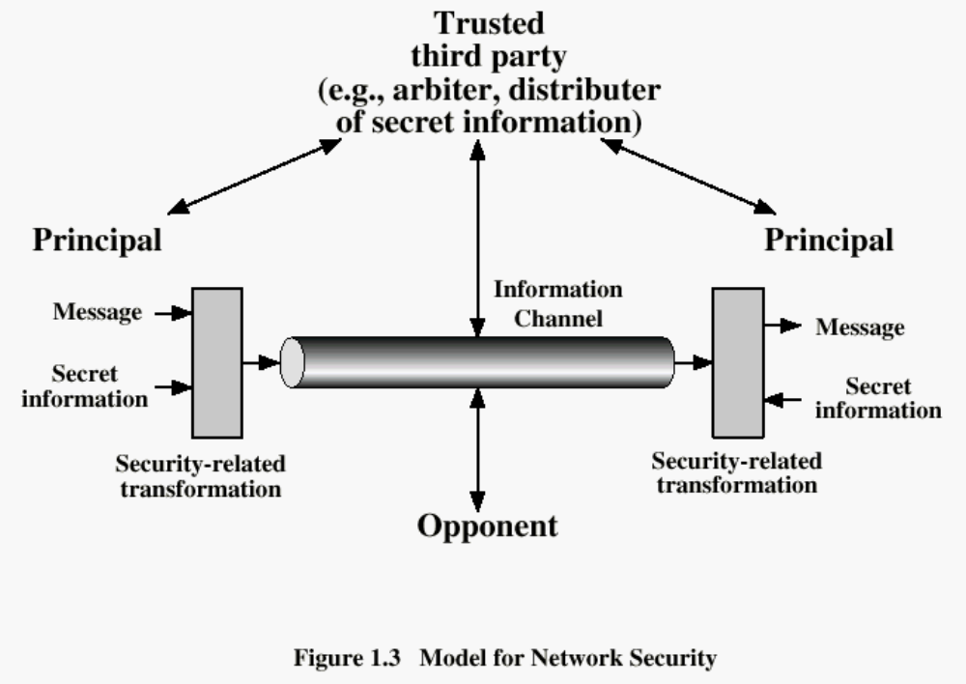
1.6 Model for Communication Security
Notes:
所有提供安全的技术有两个组成部分：
一个对要发送的消息进行的与安全相关的变换（加解密模块）；
另一个是参与通信双方共享的秘密信息（秘钥）。
可信任的第三方
设计一个安全系统需要完成以下4个基本的任务：
设计好的算法,，产生秘钥，分发秘钥，定义用于安全通信的协议。

Slide 63
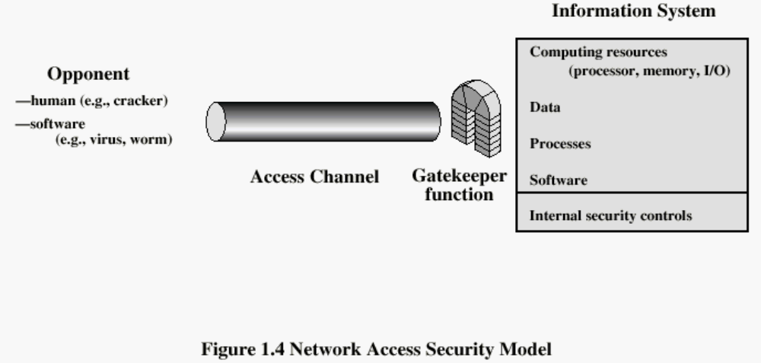
Model for Access Security

Slide 64
Methods of Defence
Encryption
Software Controls (access limitations in a data base, in operating system protect each user from other users)
Hardware Controls (smartcard)
Policies (frequent changes of passwords)
Physical Controls

Slide 65
Security Policy
• Describes what security is to be available from the network.
• Defines what is the responsibility of the system
or network and what is not
• Describes rules for using the network.
• Describes who is responsible for the
management and security of the network.

Slide 66
Security Policy---(continued)
• Describes what security is to be available from the network.
• Defines what is the responsibility of the system or network and what is not
• Describes rules for using the network.
• Describes who is responsible for the
management and security of the network

Slide 67
Generic Security Policy
• A generic authorisation policy (from ISO 7498-2):
‘Information may not be given to, accessed by, nor
permitted to be inferred by, nor may any resource be
used by, those not appropriately authorised.’
• Possible basis for more detailed policy: needs lots of refinement to produce final document:
– What information?
– What resources?
– Who is authorised and for what?

Slide 68
1.6 Internet standards and RFCs
The Internet society
  Internet Architecture Board (IAB)
  Internet Engineering Task Force (IETF)
  Internet Engineering Steering Group (IESG)

Slide 69
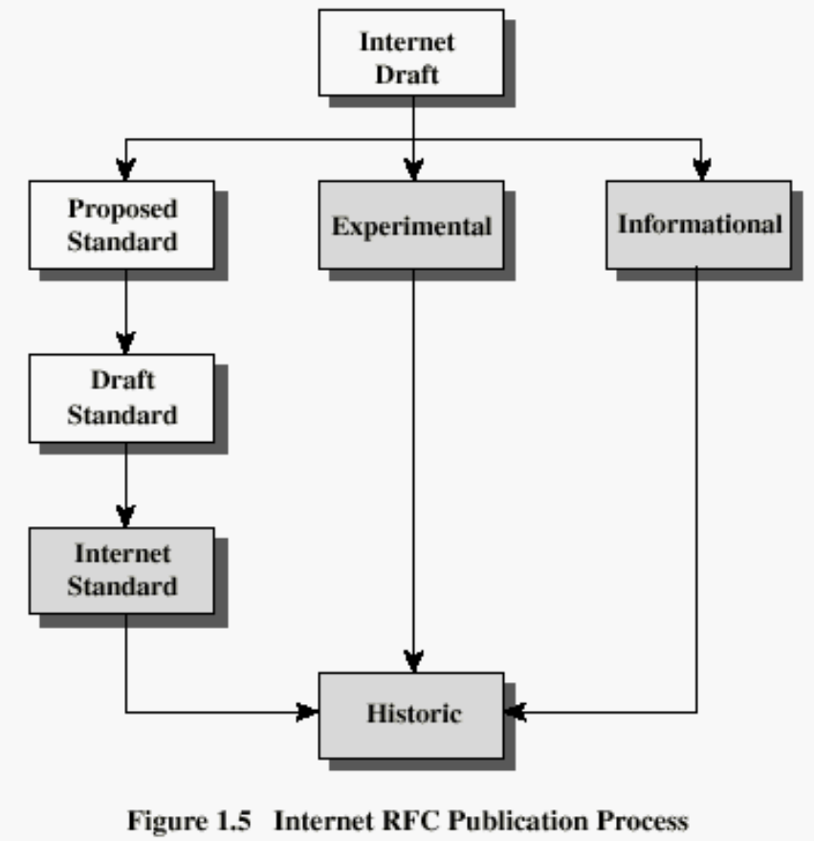
Internet RFC Publication Process

Slide 70
Recommended Reading
Pfleeger, C. Security in Computing. Prentice Hall, 1997.
Mel, H.X. Baker, D. Cryptography Decrypted. Addison Wesley, 2001.

